Slide 1
Assignment: Value Stream Mapping (VSM) – Grocery Shopping
Module 5.2 Assignment-Ayyappanpillai

Slide 2
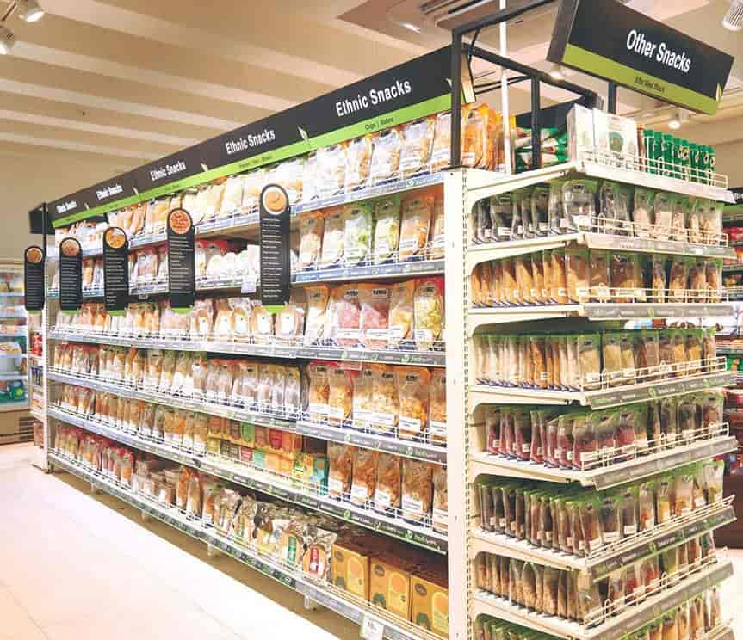
Value Stream Mapping identifies inefficiencies in a process and offers solutions for improvement. We’ll map the grocery shopping process to optimize time, resources, and effort.

Slide 3
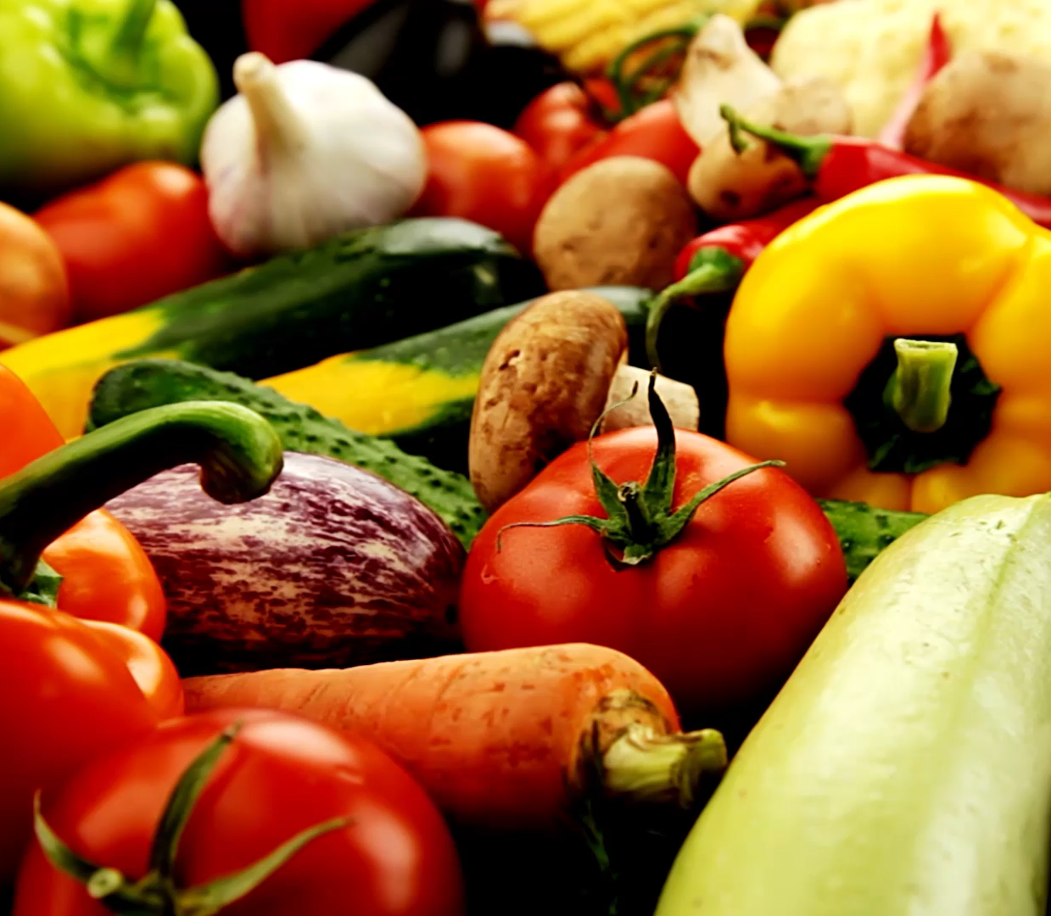
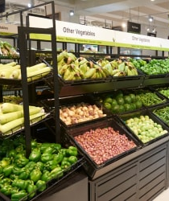
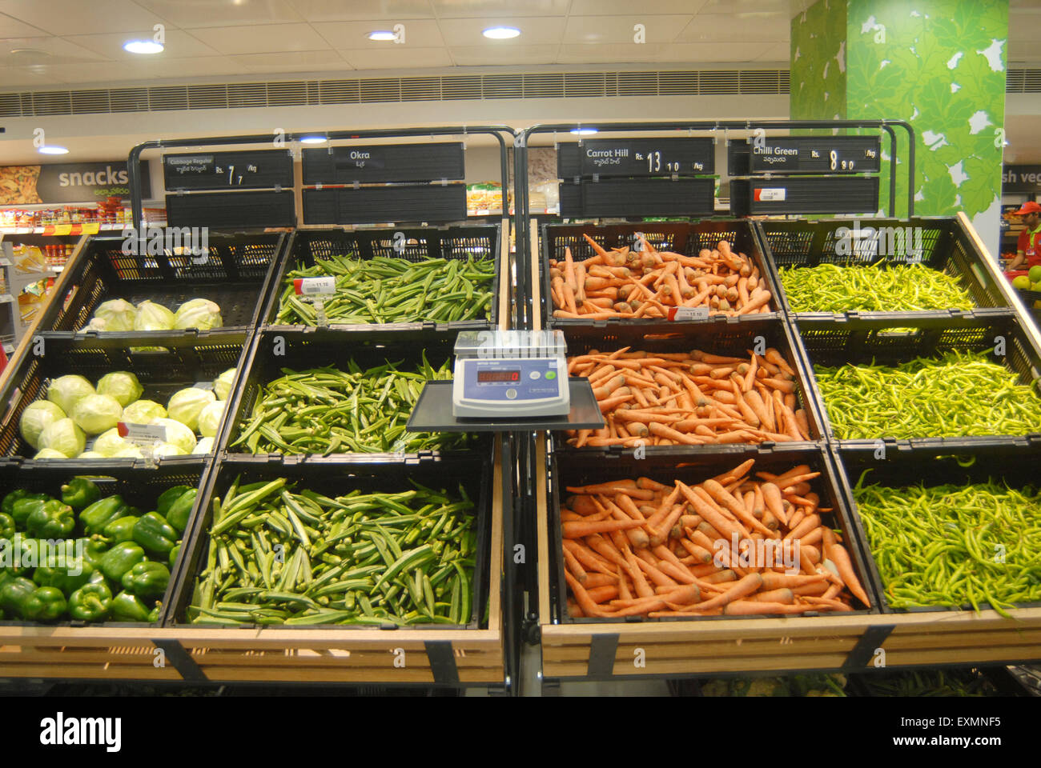
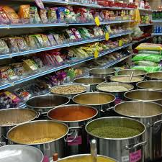
Process: Weekly grocery shopping
Timeframe: A typical shopping trip from planning to storing groceries at home

Slide 4
Total Current Cycle Time:
Process Time: 120 minutes
Wait Time: 15 minutes
Cycle Time: 135 minutes
Step | Action | Time (mins) | Wait Time (mins) | Issues
1: Plan shopping list | Check stock and write a list | 20 | 0 | Forgetting items, duplicate items
2: Drive to the store | Travel to the nearest supermarket | 15 | 0 | Traffic delays
3: Navigate the store | Find items on the list | 45 | 10 | Unfamiliar with store layout
4: Wait in checkout line | Pay for items | 10 | 5 | Long lines during peak hours
5: Drive back home | Travel from the store | 15 | 0 | Traffic delays
6: Store groceries | Organize items in the kitchen | 15 | 0 | Inefficient storage, misplaced items

Slide 5
Optimize each step to reduce inefficiencies and total time.
Total Future Cycle Time:
Process Time: 75 minutes
Wait Time: 7 minutes
Cycle Time: 82 minutes
Step | Improvement | Time (mins) | Wait Time (mins) | Expected Benefit
1: Plan shopping list | Use an app to manage and organize the list | 10 | 0 | Avoid forgetting or duplicating items
2: Drive to the store | Choose non-peak hours to avoid traffic | 10 | 0 | Reduce travel time
3: Navigate the store | Group items by store sections in the list | 30 | 5 | Quicker navigation and fewer backtracks
4: Wait in checkout line | Use self-checkout or scan-and-go options | 5 | 2 | Faster checkout
5: Drive back home | Choose optimized routes with less traffic | 10 | 0 | Reduce delays
6: Store groceries | Use labeled bins for specific items | 10 | 0 | Efficient storage and faster access

Slide 6
Analyze Lean Metrics
Lean Metrics:
Process Time Reduction: 120 mins → 75 mins (37.5% reduction).
Wait Time Reduction: 15 mins → 7 mins (53.3% reduction).
Overall Cycle Time: 135 mins → 82 mins (39.3% improvement).
Key Improvements:
Eliminated repetitive list-making errors.
Reduced navigation time using grouped item lists.
Optimized checkout with self-checkout options.

Slide 7
Optimize and Implement Visit stores during off-peak hours for shorter queues and faster shopping. Group items in the shopping list by store sections to avoid unnecessary backtracking. Use self-checkout options to minimize wait time.

Slide 8
Thank you
Rajesh Ayyappanpillai

